Slide 1


Introduction to Artificial Intelligence
Ms. Chaithra Koppala (Course coordinator)
Department of Computer Science, YIASCM

Slide 2
Program Information:
Program Name | BCA / BSc
Course / Subject Name | Introduction to Artificial Intelligence
Semester | III
Course Information:
Course Code | BCA304 / BSC304
Course Title | Introduction to Artificial Intelligence
Credits | 3
Total Contact Hours | 45 + 15 notional hours
L-P-E | 2:0:3
CA: UE Weightage | 50:50
Pass Marks (CA and UE) | 20
Aggregate Pass Marks | 40
UE Question Paper Marks | 75
Pre-requisite (if any) | 40% CIA marks and 75% attendance

Slide 3
Course Objectives (CO)
CO1 | Develop semantic-based and context-aware systems to acquire,organize, process, share and use the knowledge embedded in multimedia content.
CO2 | Design problem solving techniques using AI and generating AI games.
CO3 | Implement AI search algorithms in building AI model
CO4 | Apply first order predicate calculus to represent and solve complex problems
CO5 | Identify and analyse issues related to knowledge representation in AI
CO6 | Interpret and summarize how different NLP techniques are applied to Natural Language data.

Slide 4
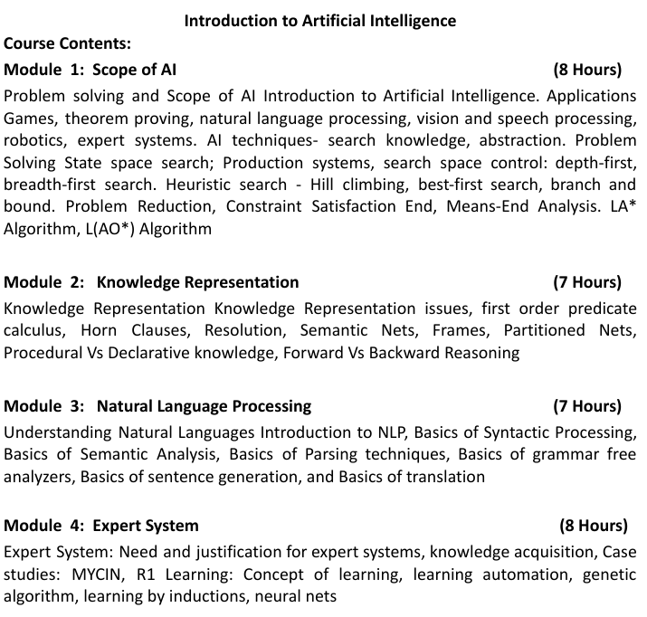

Slide 5
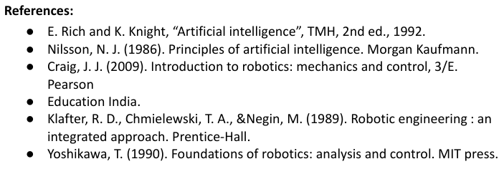
Chaithra Koppala

Slide 6
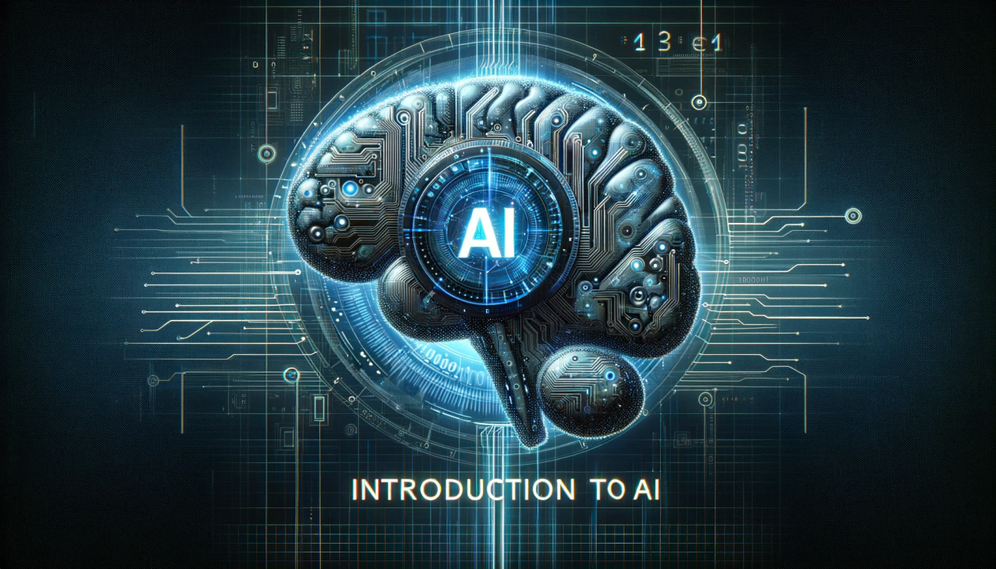
Module 01: Scope
Introduction to Artificial Intelligence: What is intelligence, what is AI Real life examples/Use cases
AI applications: Games
AI Techniques: ML,DL,NLP,Computer vision and speech processing,Expert systems,Rocotics,Fuzzy logics,Genetic Algorithm
Problem Solving in AI: State Space Search, Production Systems, Serach space control
Depth First Search, Breadth first search
Heuristic Search: Hill Climbing, Branch and Bound
Problem Reduction, Constraint Satisfaction, Means end Analysis
A*, AO* algorithm
Chaithra Koppala

Slide 7

Module 02: Knowledge Representation
Knowledge Representation Issues: Introduction to KR
Types of Knowledge (Declarative, Procedural, Meta-knowledge)
Issues in KR
First order predicate calculus: prdicate logic, Quantifiers
Horn Clauses: Syntax and examples, Conversion of predicate calculus to Horn Clauses
Resolution: Principle and algorithm, examples and applications
Semantic nets: Building, Representation of knowledge using semantic nets
Frames: Components and usage, implementation
Partitioned nets: structure and real world applications
Procedural vs Declarative knowledge
Forward vs Backward reasoning: Algorithms and examples, applications, case study and problem solving

Slide 8

Module 03: NLP
Understanding natural languages and introduction to NLP
Importance and applications
History and evolution
Basic Syntactic Processing: syntax and role in NLP
Analysis Techniques, syntax trees and parsing algorithms
Basics of semantic analysis: Difference between syntax and semantics
Parsing techniques: Top down and bottom up parsing
Context free grammars and their role
Grammar free analysers: use cases and limitations
Sentence generation: Applications, techniques, template based and probabilistic methods
Translation: Machine translation, challenges, techniques, rule based- statistical- neural translation

Slide 9

Module 04: Expert Systems
Expert Systems: Need/importance, characteristics, real world applications
Knowledge acquisition: techniques, role of knowledge engineers
MYCIN and R1: analysis of its design and functionality, its impact and limitations
Learning in AI: Types(Supervised, unsupervised, reinforcement)
Learning automation: tools and techniques
Genetic algorithm: applications
Neural nets: structure and functions of neurons and layers

Slide 10
Why Study Artificial Intelligence?
AI is a transformative technology that impacts nearly every aspect of modern life.
AI is used in diverse fields like healthcare, finance, transportation, and entertainment, offering numerous career opportunities.
Equips students with advanced problem-solving and critical thinking skills.
drives innovation, enabling the creation of new products and solutions.
growing demand for AI professionals in the job market.
combines elements of computer science, mathematics, psychology, neuroscience, and more.
Understanding AI involves grappling with its ethical implications and societal impact.
Chaithra Koppala

Slide 11


To attend semester end examination, it is mandatory to have 75% attendance and 40% of the CIA marks.
CIA is marked of 50 marks, based on the mentioned rubrics. 20 marks out of 50 is needed for SEE eligibility.
SEE examination is out of 75 marks which will be converted to 50. So total marks is 100.
There is no separate practical exams.

Slide 12
Assessment and Evaluation
Sl. No. | Assessment Component | Formative/ Summative (F/S) | Number | Marks for each | Total | Converted
1 | CIA 1: Internal test | F | 2 | 30 | 60 | 20 | 50
2 | CIA 2: Quiz |  | 2 | 10 | 20 | 5
3 | CIA 3: Classroom assignment/activities * |  | 14 + 1 | 5 + 10 | 80 | 10
4 | CIA 4: Class participation/class notes |  | 4 | 10 | 40 | 5
5 | CIA 5: Writing Assignment and viva |  | 2 | 10 | 20 | 10
6 | University Examination (UE/SEE) | S | 1 | 75 | 75 | 50 | 50
 | Total |  |  |  |  | 100 | 100

Slide 13
CIA 3: Classroom assignment/activities *
Sl. No | Assignment/activity topic | Type | Individual/ Group(I/G) | Allotted marks
1 | AI Applications | Group Discussion(GD)/ Problemathon/ Case study | G | 5 m each and 10 m for Class test
2 | Sentiment analysis | Problemathon/ GD | G
3 | BFS/DFS | Code Test/ Problemathon | I
4 | Hill Climbing Algorithm | Case Study | I
5 | A* and AO* algorithm | Research report | I
6 | Knowledge representation | Case Study/ Research report | I
7 | PL and quantifiers | Case study/ Problemathon | I
8 | Conversion | Research report | I
9 | Semantic net, Frame, Partitioned net | Case study/ Problemathon | I
10 | NLP | Research report | I
11 | Sentence analysis | GD | G
12 | Parsing techniques | Problemathon | I/G
13 | Expert system | Research report/ GD | G
14 | Automation tools | GD | G
15 | Class test | Open book test | I
Chaithra Koppala

Slide 14





General Classroom Instructions
Chaithra Koppala

Slide 15
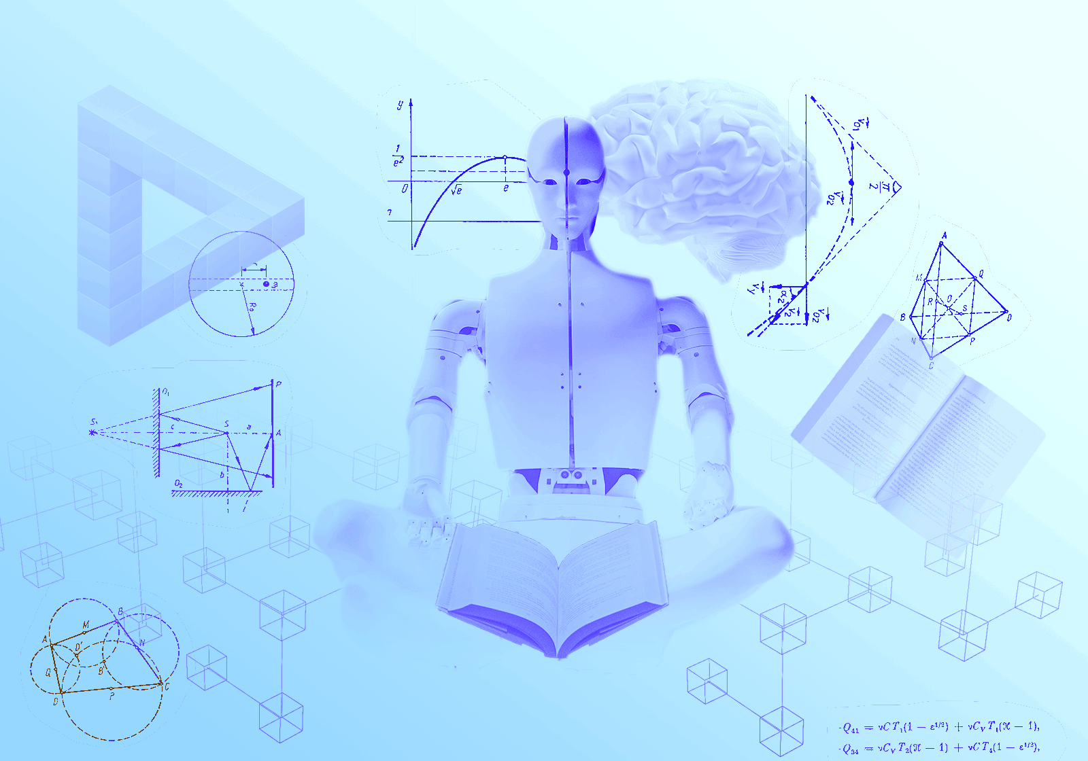

Happy Learning….
Chaithra Koppala

